Slide 1
BIO-MODELLING PROJECT
Modeling Anti-NMDAR Encephalitis
using Petri Nets
A discrete stochastic Petri net of NMDAR signalling and its downstream neurodegeneration pathway, baseline vs. anti-NMDAR perturbation.
Alexa van Thiel (s3617238) | Ali Momen (s4993128) | Thijs Vijgeboom (s2648261)
LIACS, Leiden University, the Netherlands

Slide 2
OVERVIEW
Outline
1
Introduction The disease, the gap, the research question
2
Biological Background Encephalitis, NMDAR, and the autoimmune mechanism
3
Bio-modeling Petri net definitions, decisions, and the two coupled modules
4
Analysis and Results Validation of baseline vs. perturbation dynamics
5
Conclusions Findings, limitations, and future work
Anti-NMDAR Encephalitis | Petri Net Modelling Leiden University, LIACS
2

Slide 3
Section 1
Introduction
The disease, the gap it leaves, and the question we ask

Slide 4
1 INTRODUCTION
An autoimmune attack on the synapse
● Anti-NMDAR encephalitis is an autoimmune disease: IgG autoantibodies target the GluN1 subunit of NMDARs.
● Antibodies crosslink and internalise the receptors, lowering surface NMDAR density and reducing Ca2+ entry into the neuron.
● Clinical picture: psychiatric symptoms (psychosis, agitation), memory deficits, seizures, and movement disorders.
● The gap: individual pathways are well studied, but no integrated model links reduced NMDAR activity to the balance of protective vs. damaging pathways over time.
● Petri nets are an established formalism for biological signalling and synaptic plasticity, so they fit this question well.
▦ FIGURE PLACEHOLDER
Replace this box with the image below
Web image: https://commons.wikimedia.org/wiki/File:NMDA_receptor.jpg
NMDA receptor at a glutamatergic synapse: GluN1 / GluN2 tetramer gating Ca2+ influx.
Anti-NMDAR Encephalitis | Petri Net Modelling Leiden University, LIACS
4

Slide 5
1 INTRODUCTION
Research question and hypothesis
Research question
How does antibody-mediated NMDAR depletion alter the dynamic balance between calcium-dependent survival, oxidative stress, and apoptotic signalling?
● Hypothesis: reduced Ca2+ influx lowers activation of the CaMKII and NF-kB survival / plasticity pathways, while increasing relative flux through ROS and CHOP / CASP3, favouring oxidative stress and apoptosis.
● Comparison strategy: a healthy baseline net and an anti-NMDAR perturbation net that share identical core conditions, so any divergence comes only from the disease-specific machinery.
● Validation plan: simulation of token distributions, baseline vs. perturbed initial markings, reachability analysis, and sensitivity analysis (supported by Charlie and Snoopy exports).
Anti-NMDAR Encephalitis | Petri Net Modelling Leiden University, LIACS
5

Slide 6
Section 2
Biological Background
Encephalitis, the NMDA receptor, and the autoimmune mechanism

Slide 7
2 BIOLOGICAL BACKGROUND
Encephalitis and its autoimmune subtype
● Encephalitis is acute inflammation of the brain parenchyma, causing altered consciousness, seizures, and behavioural changes.
● Infectious (IE): pathogen-driven (HSV, enteroviruses, arboviruses).
● Autoimmune (AE): antibodies against neuronal surface or intracellular antigens.
● Often misdiagnosed: the high variance of causative agents leads to overlapping, ubiquitous pathology.
● Anti-NMDAR encephalitis is an AE subtype, driven by patient IgG against the NMDA receptor - the focus of this project.
▦ FIGURE PLACEHOLDER
Replace this box with the image below
Web image: https://www.frontiersin.org/journals/neurology/articles/10.3389/fneur.2022.834929/full
T2 / FLAIR hyperintensities reported in anti-NMDAR encephalitis (limbic and cortical regions).
Anti-NMDAR Encephalitis | Petri Net Modelling Leiden University, LIACS
7

Slide 8
2 BIOLOGICAL BACKGROUND
NMDAR and the autoimmune mechanism
● NMDAR: a glutamate-gated ion channel with a voltage-dependent Mg2+ block; a heterotetramer of GluN1 + GluN2 subunits.
● It gates Ca2+ influx that is central to long-term potentiation (LTP), synaptic plasticity, and neuronal survival.
● Patients produce IgG autoantibodies mainly against the GluN1 domain.
● Pathogenic cascade:
– antibody binds extracellular GluN1,
– surface receptors are crosslinked,
– the NMDAR-antibody complex is internalised,
– surface NMDAR density falls -> NMDAR loss of function.
▦ FIGURE PLACEHOLDER
Replace this box with the image below
Web image: https://doi.org/10.1056/NEJMra1708712 (Dalmau & Graus 2018, Fig. 1)
Antibody binding, crosslinking, and internalisation of surface NMDARs in anti-NMDAR encephalitis.
Anti-NMDAR Encephalitis | Petri Net Modelling Leiden University, LIACS
8

Slide 9
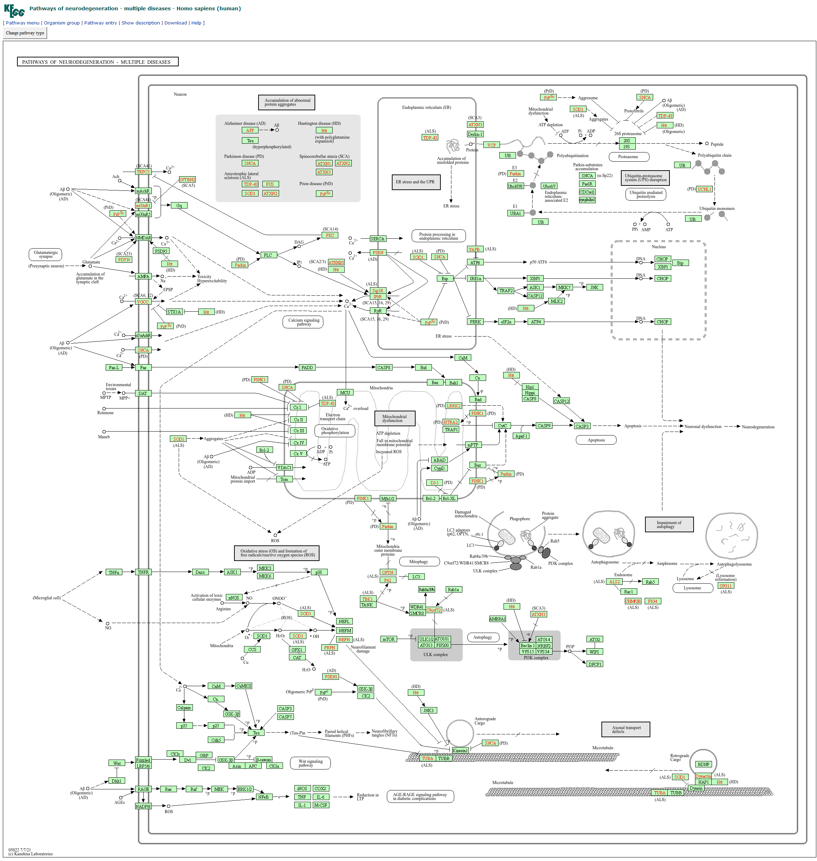
2 BIOLOGICAL BACKGROUND
Downstream consequences of NMDAR loss
● Healthy: Ca2+ -> CaMKII and CREB / NF-kB -> LTP, gene expression, and neuronal survival.
● NMDAR loss disrupts Ca2+ homeostasis and tips the balance:
– ER stress -> CHOP (DDIT3), a pro-apoptotic factor,
– mitochondrial Ca2+ imbalance -> ROS / oxidative stress,
– convergence on CASP3 -> apoptosis / neurodegeneration,
– reduced NF-kB signalling -> impaired LTP.
● Our model is a truncated slice of KEGG hsa05022, keeping only the branches downstream of NMDAR dysfunction.
KEGG neurodegeneration pathway (hsa05022) that our model is a part of; web source: https://www.kegg.jp/pathway/hsa05022
Anti-NMDAR Encephalitis | Petri Net Modelling Leiden University, LIACS
9

Slide 10
Section 3
Bio-modeling
Petri net definitions, modelling decisions, and the two modules

Slide 11
3 BIO-MODELING > 3.1 TECHNICAL DEFINITIONS
A discrete stochastic Petri net (SPN)
● We model NMDAR signalling at a glutamatergic synapse as a discrete stochastic Petri net.
● A Petri net is a 5-tuple N = (P, T, F, W, M0):
– P places - molecular species or states,
– T transitions - biochemical reactions or events,
– F flow relation - directed arcs between places and transitions,
– W arc weights - stoichiometry,
– M0 initial marking - tokens per place.
● Stochastic firing via the Gillespie SSA: each transition fires with a mass-action propensity over its input tokens.
● A transition is enabled when every input place holds at least the arc weight; one firing per SSA step; ordinary arcs only.
Propensity (mass action)
– a(t) = k . product over input places of m(p)! / [ (m(p) - w(p))! . w(p)! ]
– k is the rate constant, m(p) the marking of input place p, w(p) the arc weight.
– Built in a small, fully introspectable Python Petri-net core.
– Exported to Snoopy (.spn / .cpn) and Charlie (APNN / ANDL) for external analysis.
Anti-NMDAR Encephalitis | Petri Net Modelling Leiden University, LIACS
11

Slide 12
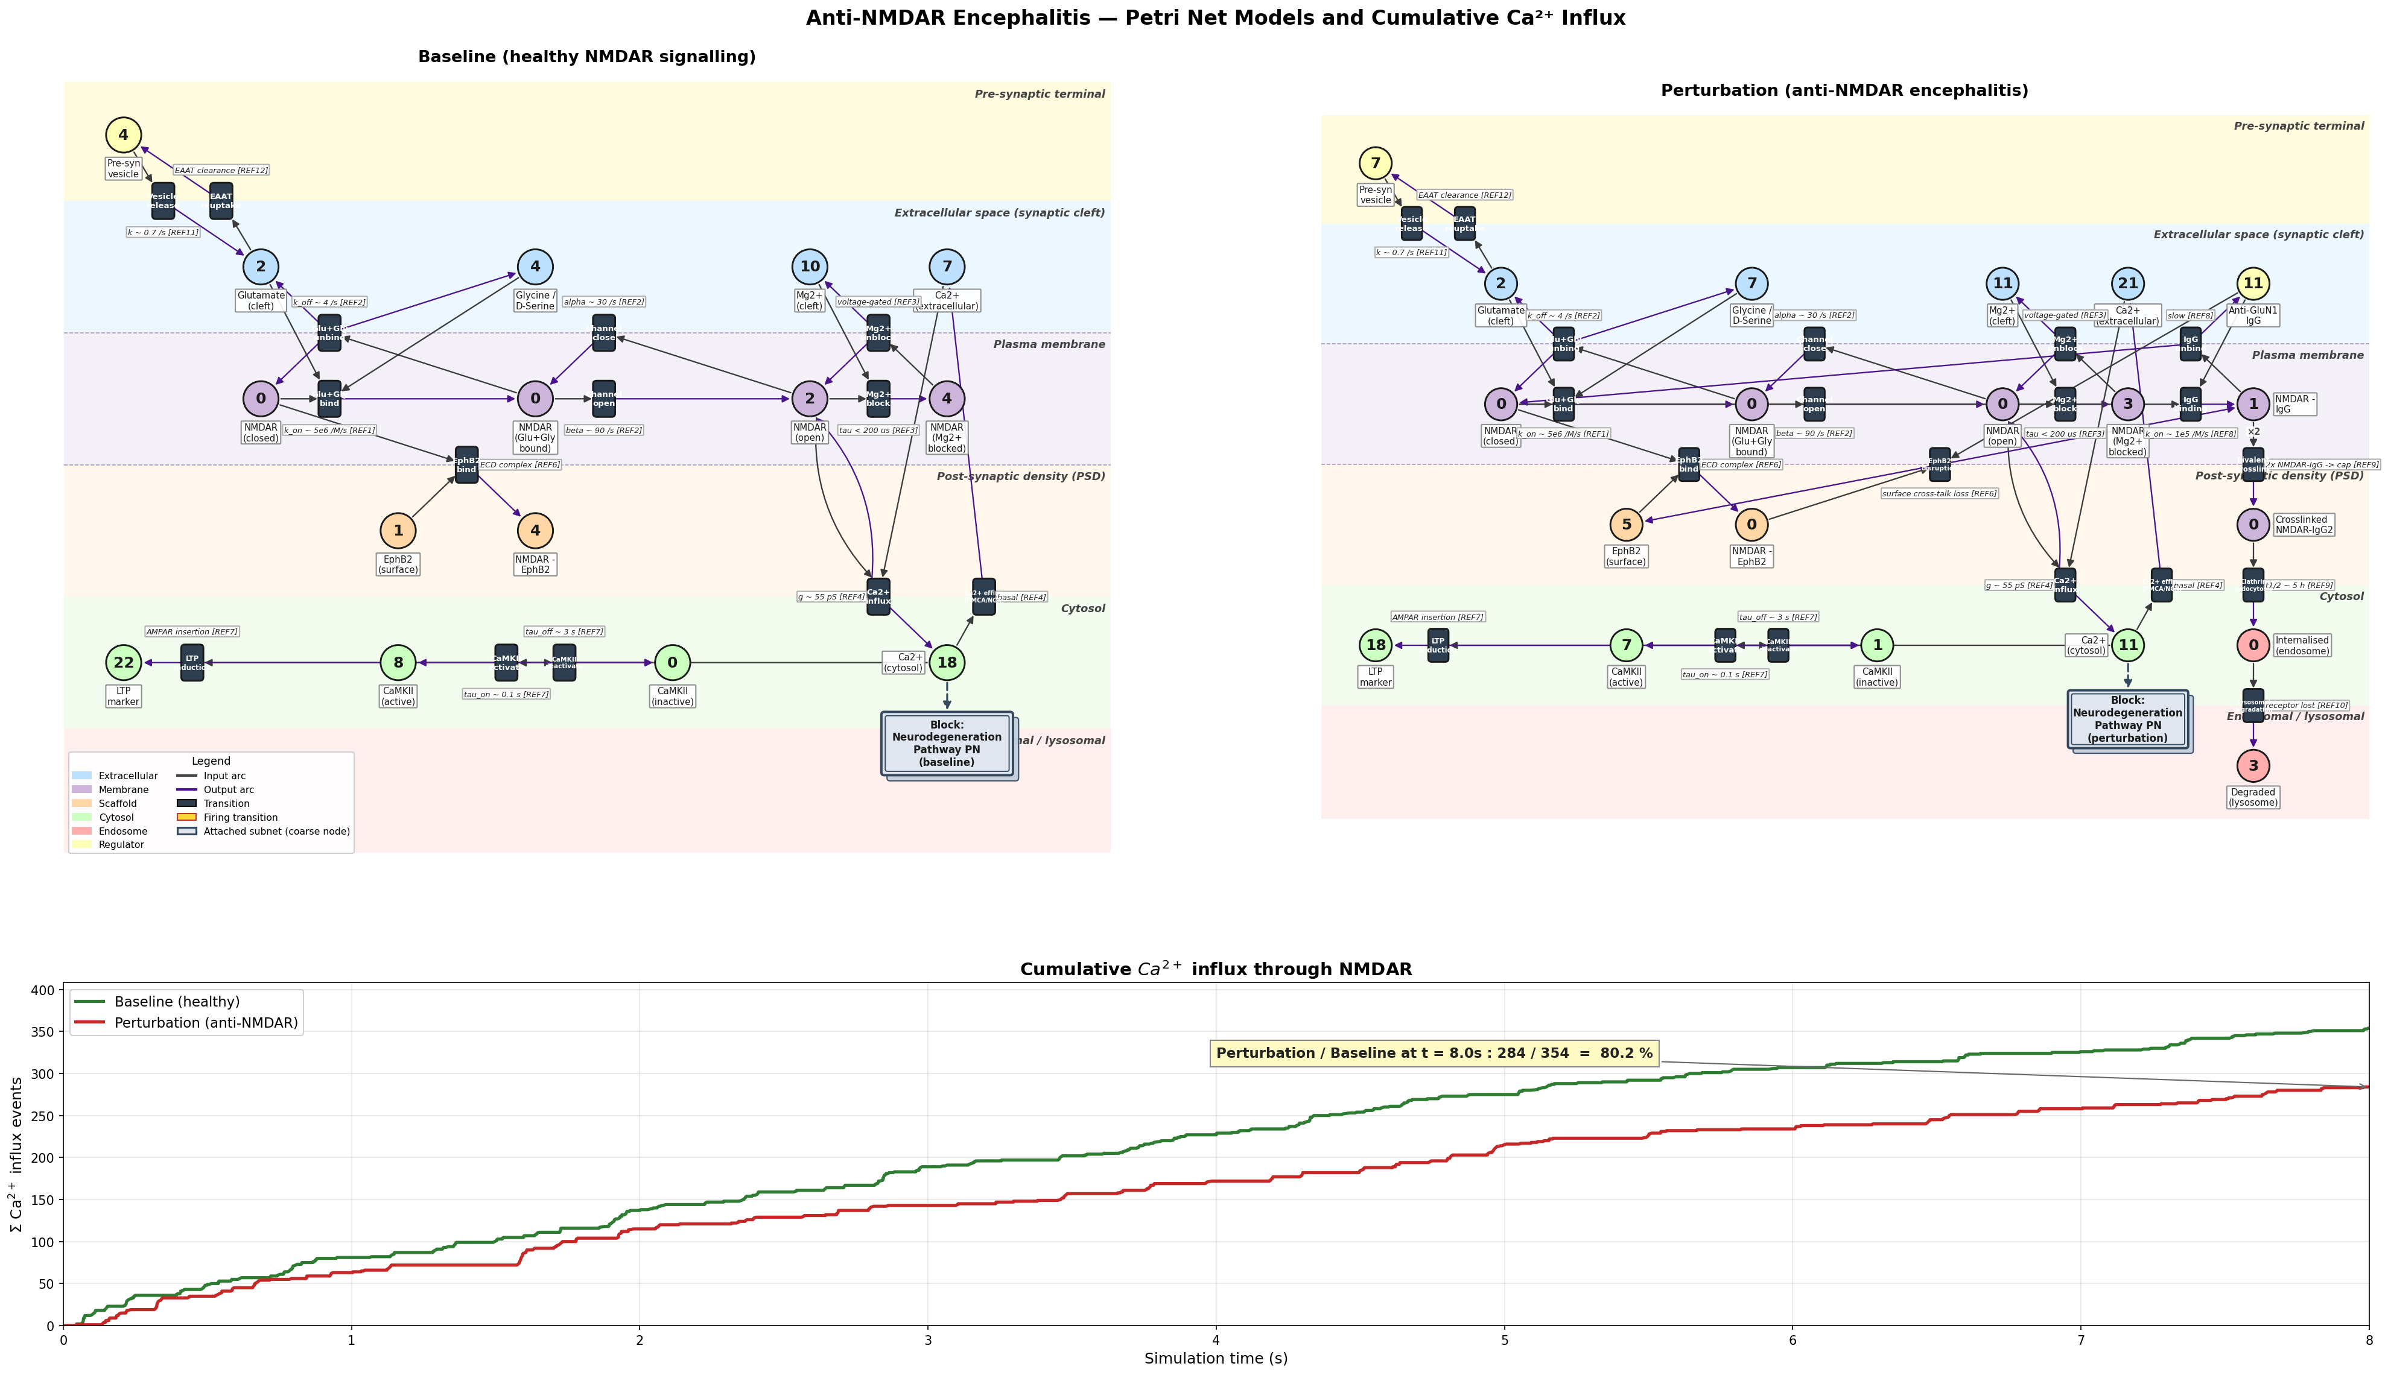
3 BIO-MODELING > 3.2 MODELING DECISIONS
Two coupled nets sharing cytosolic Ca2+
● The model is split into two coupled SPNs joined by a shared cytosolic Ca2+ place - the interface between synaptic signalling and downstream neurodegeneration.
● Each module has a baseline and a perturbation version; all are simulated for 100 Gillespie SSA runs.
● Perturbation adds antibody dynamics (k_on ~ 1e5 /M/s), bivalent crosslinking, and lysosomal degradation, progressively losing surface NMDARs.
● Faithful comparison: identical core initial conditions, so every divergence comes from the disease-specific machinery alone.
What the perturbation adds
– NMDAR + Anti-GluN1 IgG -> NMDAR-IgG (T_Ab_bind)
– 2x NMDAR-IgG -> crosslinked cap (T_crosslink)
– NMDAR-EphB2 + IgG -> EphB2 disruption (Mikasova 2012)
– crosslinked cap -> endosome (T_endocytosis)
– endosome -> lysosome (receptor pool lost)
– Net effect: surface NMDAR pool drains -> Ca2+ influx and the CaMKII / LTP cascade collapse.
Side-by-side overview: baseline (left) and perturbation (right) NMDAR nets with the cumulative Ca2+ curve.
Anti-NMDAR Encephalitis | Petri Net Modelling Leiden University, LIACS
12

Slide 13
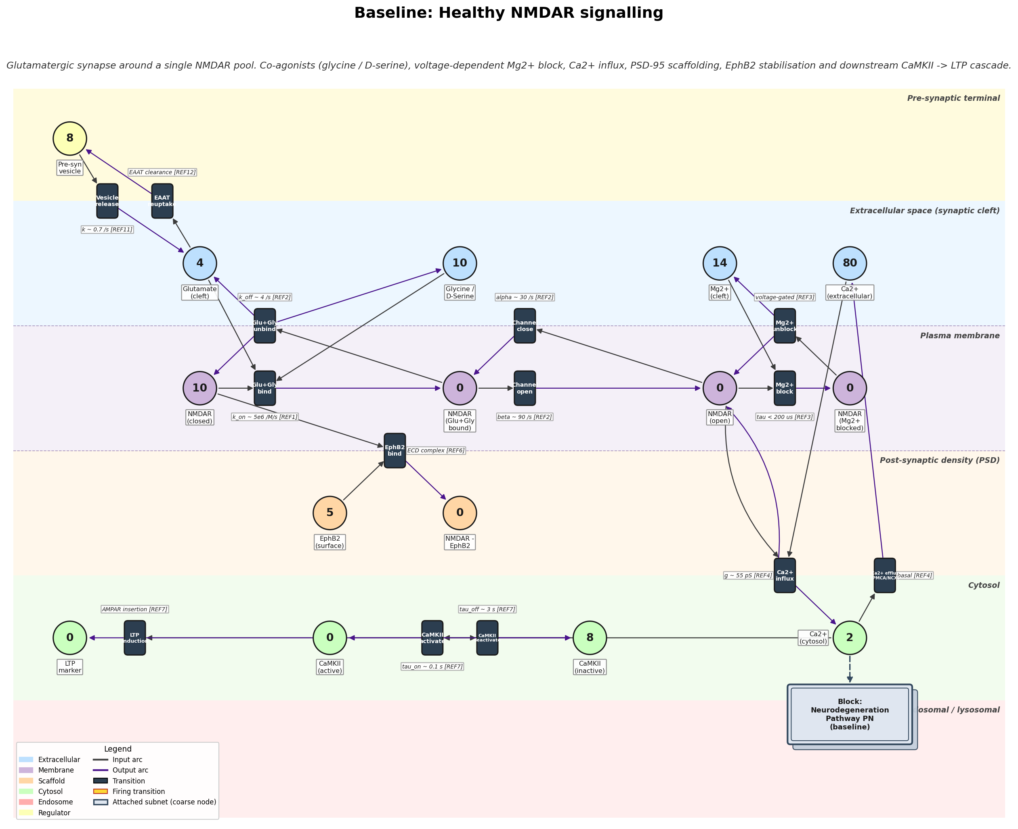
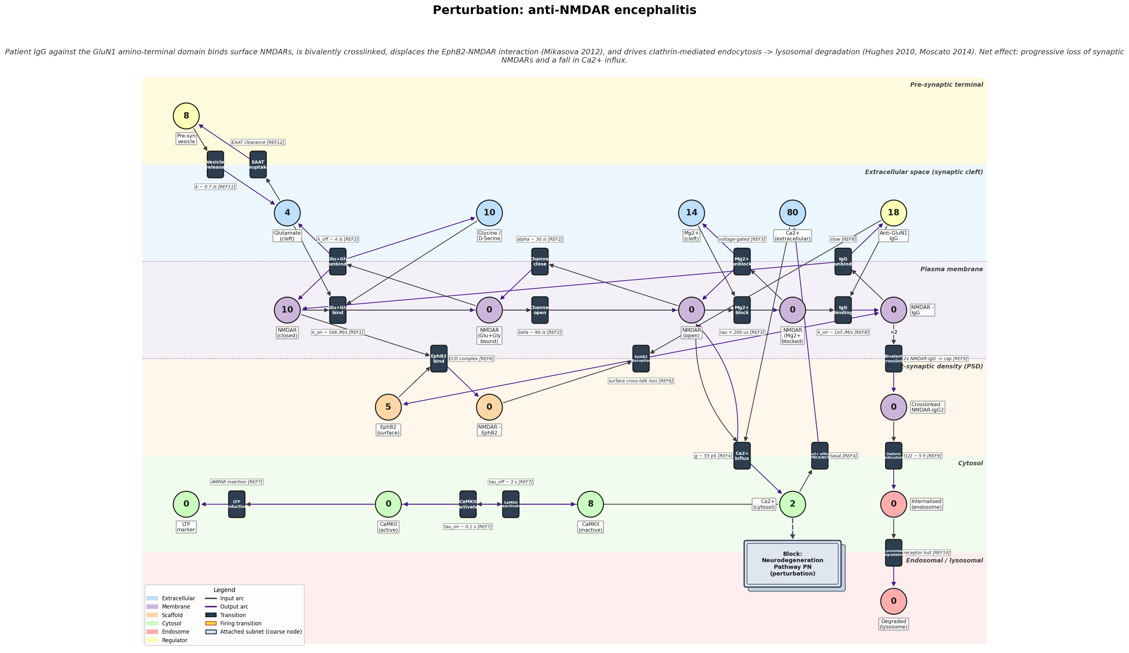
3.2.1 ANTI-NMDAR CA2+ INFLUX MODULE
The glutamatergic synapse, healthy and perturbed
● Models presynaptic vesicle release, glutamate + glycine binding, voltage-dependent Mg2+ block / unblock, channel opening, Ca2+ influx and extrusion (PMCA / NCX), and CaMKII / LTP activation.
● The perturbation variant adds antibody-mediated internalisation: tokens drain from NMDAR (closed) into Degraded (lysosome), lowering the Ca2+ influx events that feed the downstream net.
Baseline: healthy NMDAR signalling Petri net at t = 0.
Perturbation: anti-NMDAR net with IgG binding, crosslinking, endocytosis, and lysosomal degradation.
Anti-NMDAR Encephalitis | Petri Net Modelling Leiden University, LIACS
13

Slide 14
3.2.1 ANTI-NMDAR CA2+ INFLUX MODULE
Places and initial markings
Place | Baseline | Perturbation
Pre-synaptic vesicle | 8 | 8
Glutamate (cleft) | 4 | 4
Glycine / D-Serine | 10 | 10
Mg2+ (cleft) | 14 | 14
Ca2+ (extracellular) | 80 | 80
NMDAR (closed) | 10 | 10
EphB2 (surface) | 5 | 5
PSD-95 (free) | 6 | 6
CaMKII (inactive) | 8 | 8
Ca2+ (cytosol) | 2 | 2
Anti-GluN1 IgG | - | 18
Internalised (endosome) | - | 0
Degraded (lysosome) | - | 0
Reading the table
– Both nets share identical core synaptic conditions.
– The perturbation adds three places (shown as '-' in baseline): Anti-GluN1 IgG (18, the patient antibody pool), Internalised (endosome), and Degraded (lysosome).
– Tokens flow NMDAR (closed) -> internalisation -> Degraded, depleting the surface pool and the rate of Ca2+ influx.
– Any downstream divergence is therefore due to antibody-driven internalisation, not different starting conditions.
Anti-NMDAR Encephalitis | Petri Net Modelling Leiden University, LIACS
14

Slide 15
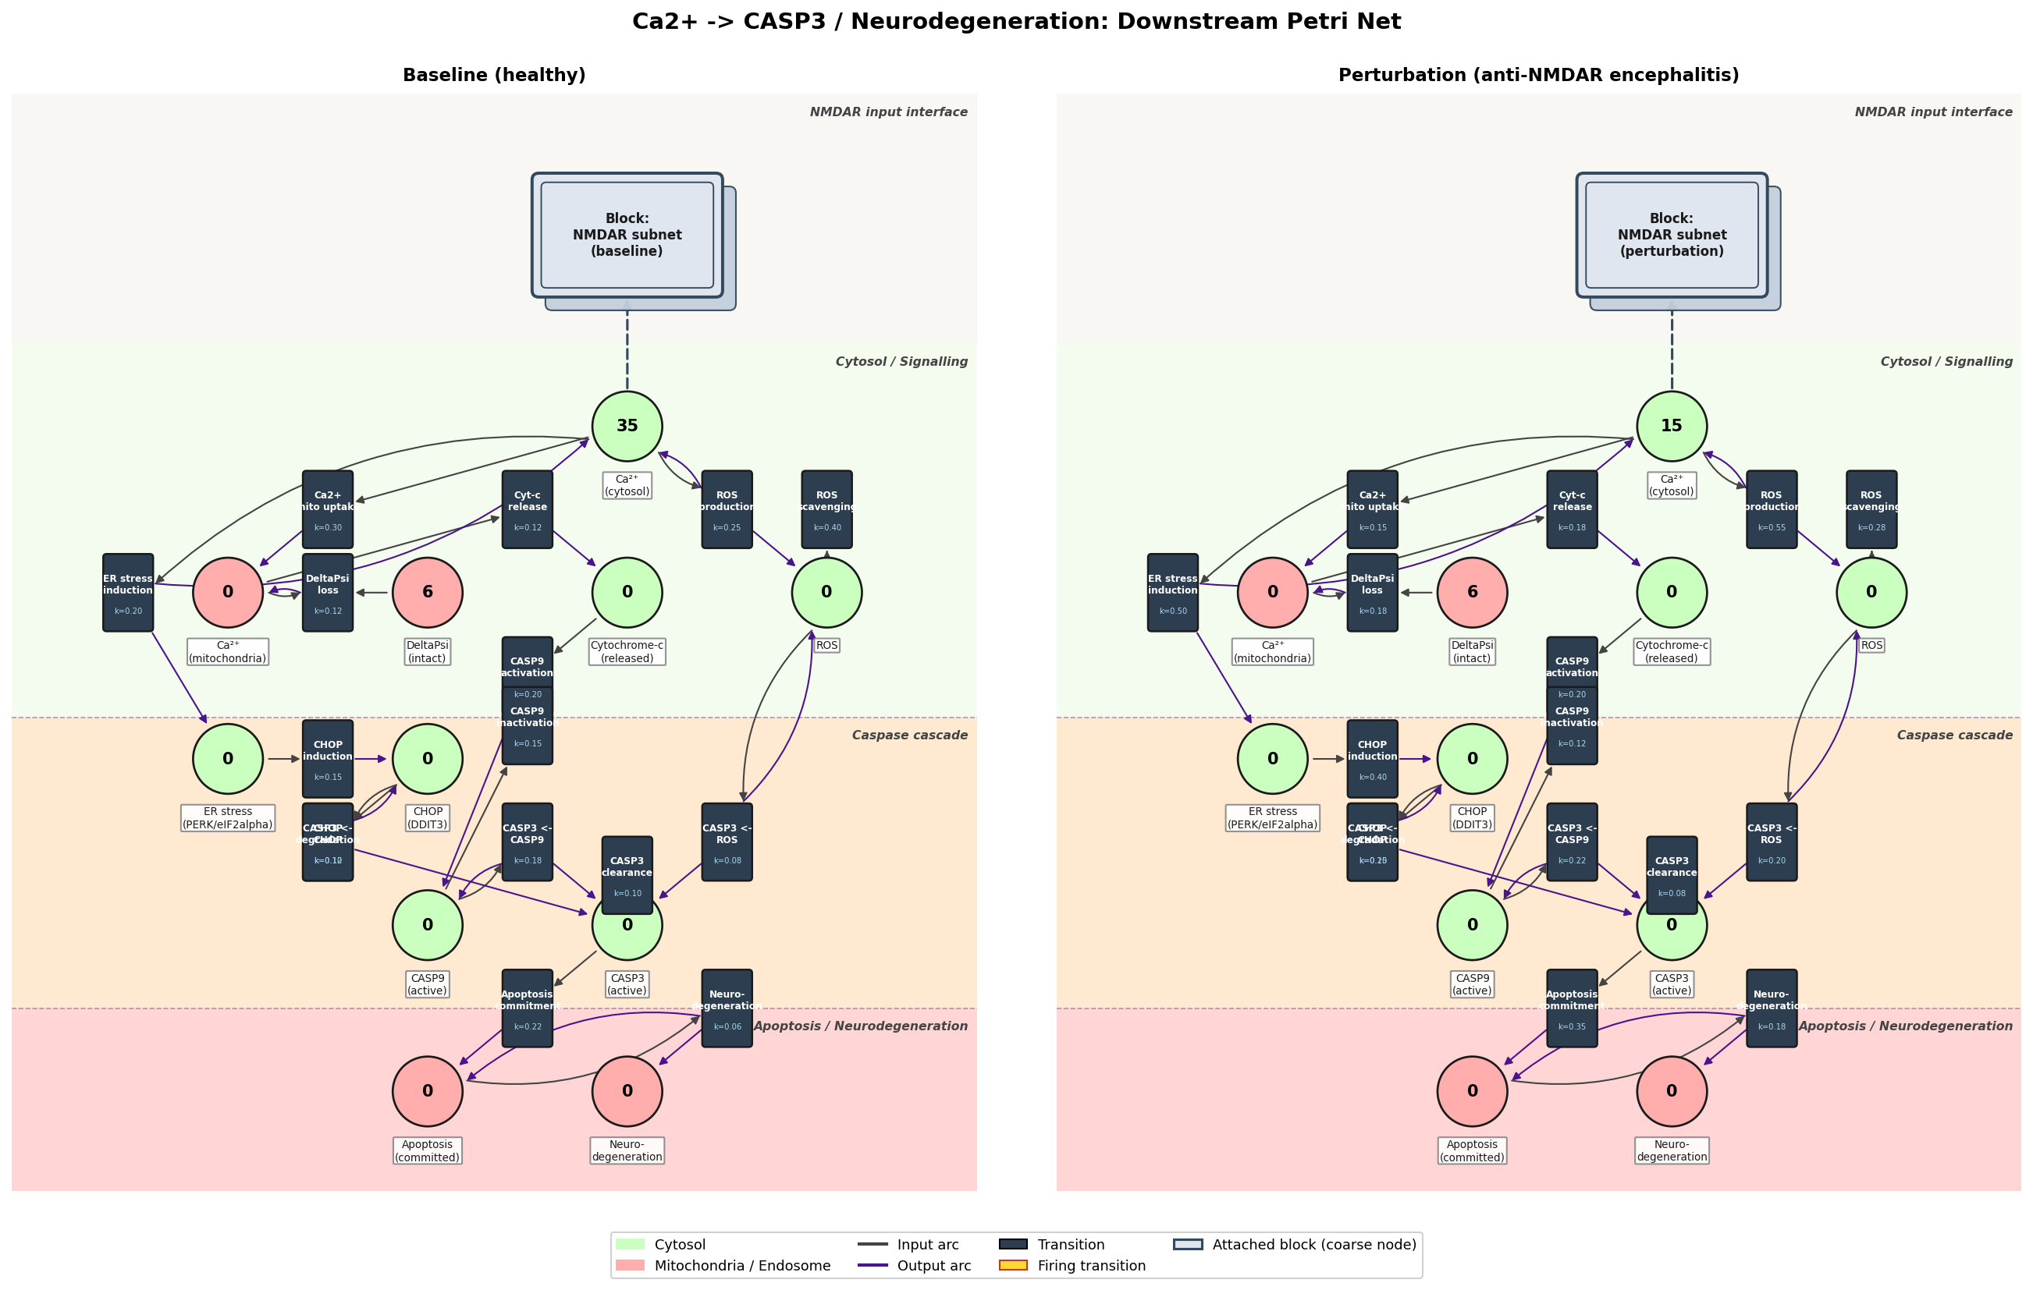
3.2.2 DOWNSTREAM APOPTOTIC MODULE
From cytosolic Ca2+ to neurodegeneration
● This module takes cytosolic Ca2+ as its sole input and models three converging pathways:
– Mitochondrial Ca2+ uptake -> loss of membrane potential -> cytochrome-c release -> CASP9,
– ER stress -> CHOP (DDIT3),
– ROS generation and scavenging.
● CASP3 is the convergence point: it integrates the CASP9, CHOP, and ROS inputs.
● Active CASP3 -> apoptosis commitment -> a neurodegeneration firing transition that accumulates damage.
Downstream Petri nets at t = 0: baseline (left, Ca2+ = 35) and perturbation (right, Ca2+ = 15).
Anti-NMDAR Encephalitis | Petri Net Modelling Leiden University, LIACS
15

Slide 16
3.2.2 DOWNSTREAM APOPTOTIC MODULE
Perturbed rate constants and markings
Parameter | Baseline | Perturbation
Initial Ca2+ (cytosol) | 35 | 15
ER stress induction (k) | 0.20 | 0.50
Ca2+-mito uptake (k) | 0.30 | 0.15
CHOP induction (k) | 0.15 | 0.40
Apoptosis commitment (k) | 0.22 | 0.35
Neurodegeneration firing (k) | 0.06 | 0.18
Why these changes
– Lower initial Ca2+ (15 vs. 35) reflects antibody-mediated receptor loss upstream.
– Higher ER-stress induction (0.50 vs. 0.20) reflects enhanced cellular stress sensitivity under NMDAR dysfunction.
– Reduced Ca2+-mito uptake (0.15 vs. 0.30) follows the lower cytosolic Ca2+.
– All other rate constants are held identical, isolating the effect of altered Ca2+ signalling and ER-stress susceptibility.
Anti-NMDAR Encephalitis | Petri Net Modelling Leiden University, LIACS
16

Slide 17
Section 4
Analysis and Results
Validating baseline against the anti-NMDAR perturbation

Slide 18
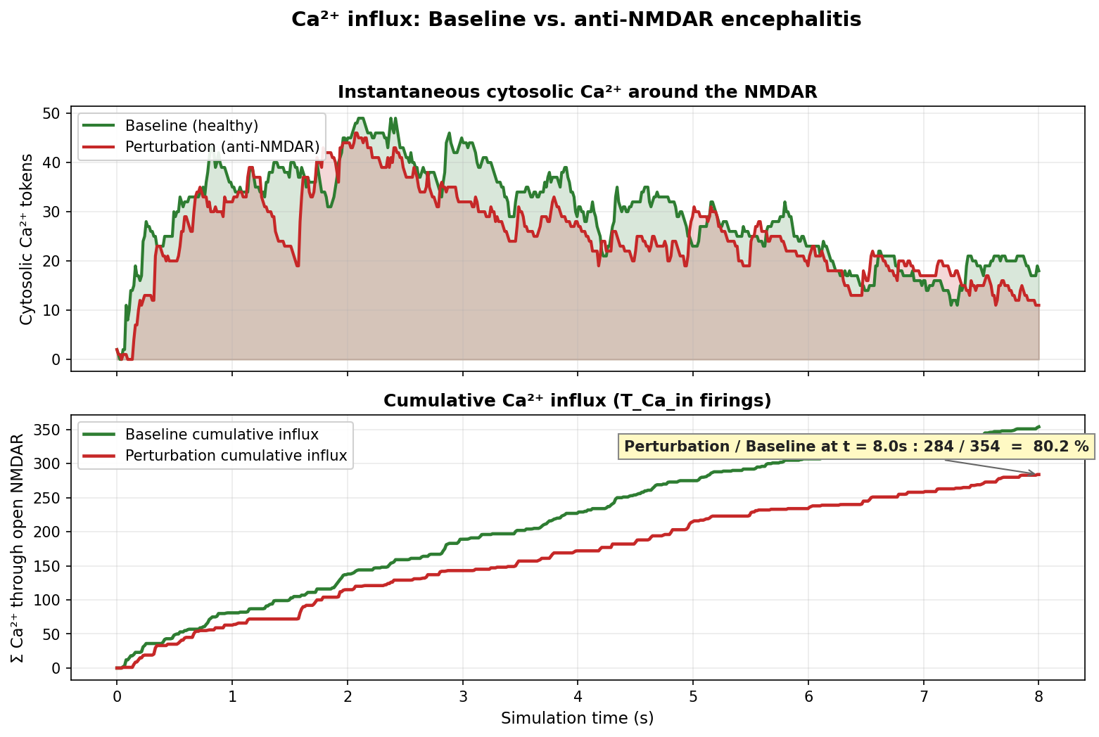
4 ANALYSIS AND RESULTS > 4.1 VALIDATION
Calcium influx: healthy vs. anti-NMDAR
● Healthy signalling (green) sustains higher cytosolic Ca2+ and greater cumulative influx than the perturbation (red).
● After 8 s, cumulative Ca2+ influx in the perturbation falls to 43.1% of baseline,
– which directly reflects antibody-driven NMDAR dysfunction.
● This collapse is the input signal handed to the downstream apoptotic module.
Instantaneous cytosolic Ca2+ (top) and cumulative T_Ca_in firings (bottom); perturbation reaches 43.1% of baseline.
Anti-NMDAR Encephalitis | Petri Net Modelling Leiden University, LIACS
18

Slide 19
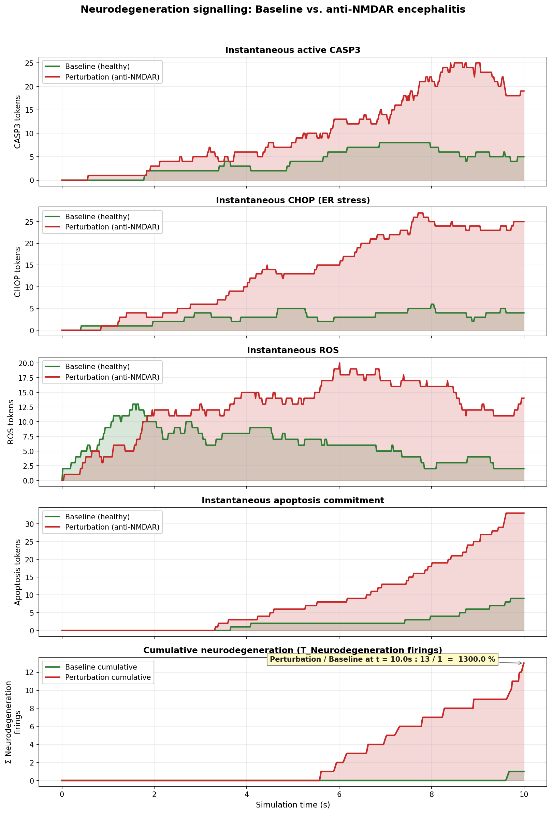
4 ANALYSIS AND RESULTS > 4.1 VALIDATION
Downstream trajectories over 10 s
● A single SSA run, baseline (green) vs. perturbation (red).
● All markers - active CASP3, CHOP, ROS, apoptosis commitment, and cumulative neurodegeneration - are elevated under perturbation.
● Divergence emerges after t ~ 2 s.
● Cumulative neurodegeneration firings: 13 (perturbation) vs. 1 (baseline) by t = 10 s, a 13-fold increase.
Five-panel trajectory: CASP3, CHOP, ROS, apoptosis tokens, and cumulative neurodegeneration firings.
Anti-NMDAR Encephalitis | Petri Net Modelling Leiden University, LIACS
19

Slide 20
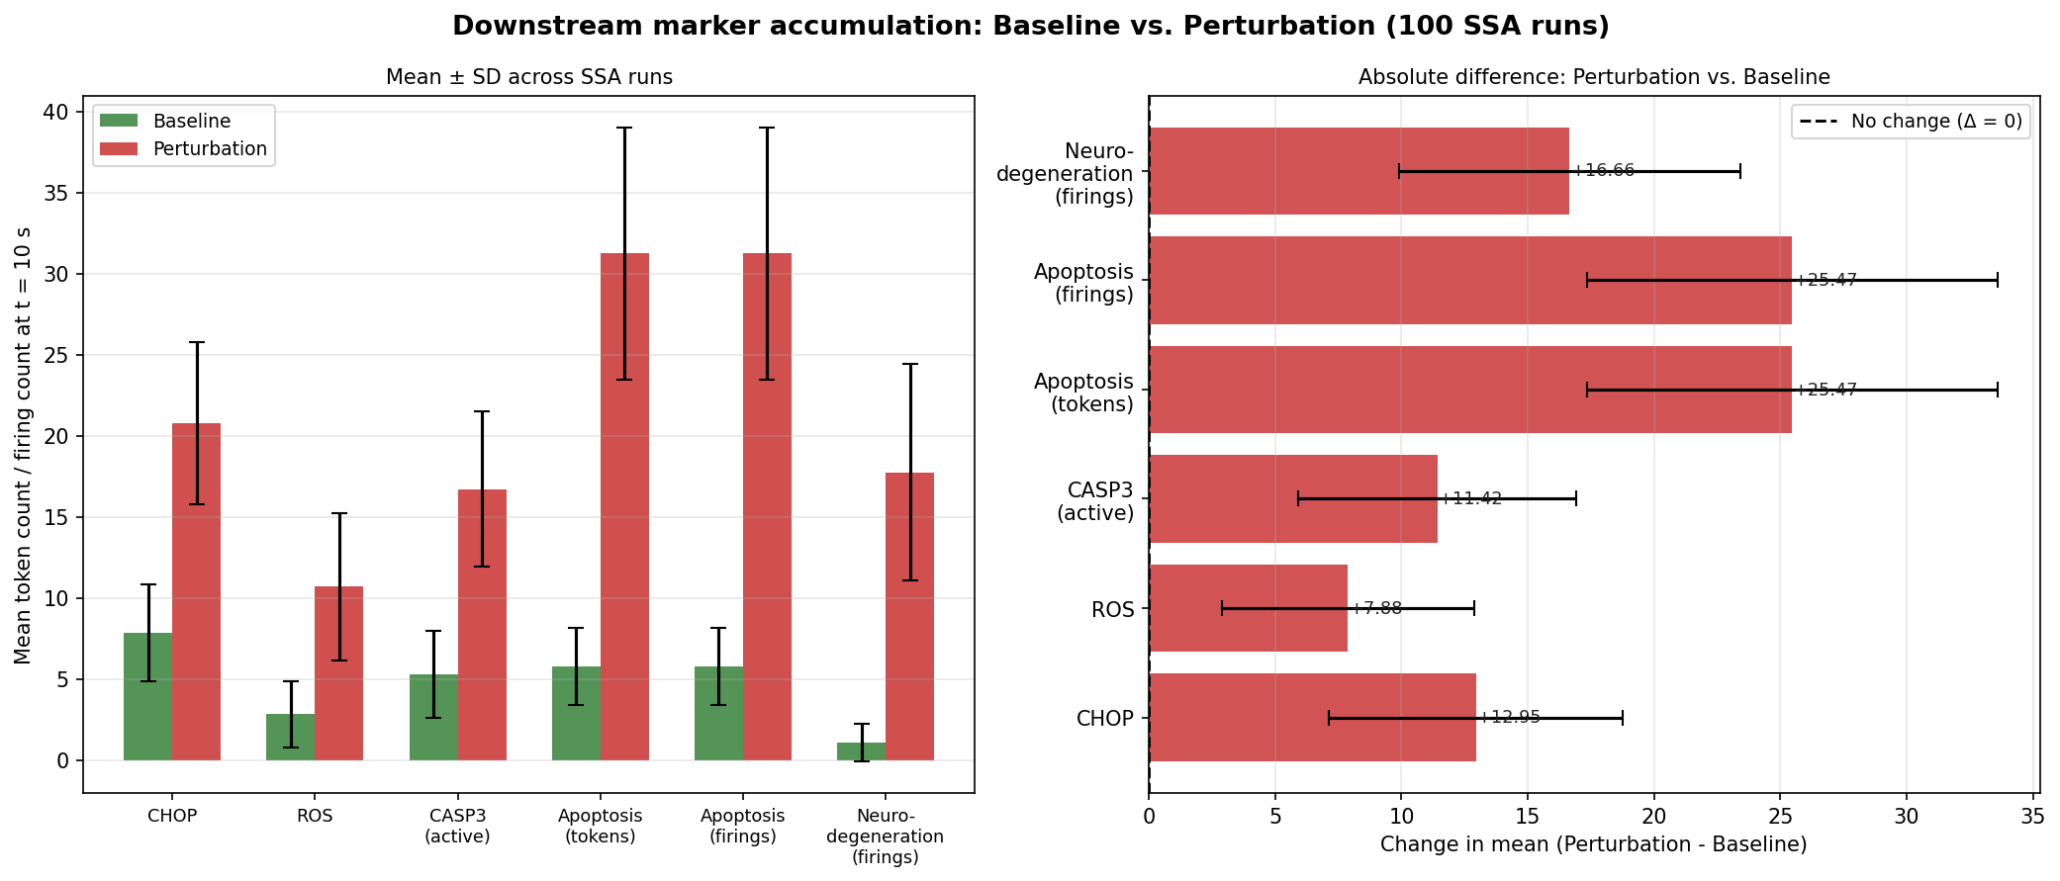
4 ANALYSIS AND RESULTS > 4.1 VALIDATION
Ensemble comparison across 100 runs
● Marker accumulation at t = 10 s across 100 SSA runs (mean +/- SD).
● All markers are significantly elevated under perturbation.
● Largest effects:
– apoptosis commitment, delta = 25.47,
– neurodegeneration firings, delta = 16.66.
● This supports the hypothesis: NMDAR depletion shifts the balance toward oxidative stress and apoptosis.
Mean +/- SD marker counts (left) and the perturbation - baseline difference (right) over 100 runs.
Anti-NMDAR Encephalitis | Petri Net Modelling Leiden University, LIACS
20

Slide 21
Section 5
Conclusions
Findings, limitations, and where this could go next

Slide 22
5 CONCLUSIONS
What the model shows
● An integrated, two-module stochastic Petri net reproduces the anti-NMDAR phenotype:
– antibody-driven receptor loss -> reduced Ca2+ influx -> a shift from survival (CaMKII / NF-kB / LTP) toward stress and apoptosis (ROS, CHOP, CASP3, neurodegeneration).
● Quantitatively:
– Ca2+ influx drops to about 43% of baseline,
– cumulative neurodegeneration rises roughly 13-fold,
– apoptosis commitment is the largest ensemble effect (delta = 25.47).
● Hypothesis supported: NMDAR depletion tips the protective / damaging balance toward damage, consistent with the anti-NMDAR encephalitis literature.
Anti-NMDAR Encephalitis | Petri Net Modelling Leiden University, LIACS
22

Slide 23
5 CONCLUSIONS
Limitations and future work
Limitations
– Mass-action rates are scaled for an 8-10 s simulation window, not absolute physiological constants.
– Sparse quantitative data exist for many transition rates.
– The net is discrete, stochastic, and uncoloured; the downstream perturbation is encoded as a few hand-tuned rate changes.
– Ordinary arcs only - no inhibitor or read arcs in this version.
Future work
– Estimate rates on the critical subgraph and move to a continuous (ODE) net where data allow.
– Add inhibitor / read arcs and coloured tokens for richer logic.
– Formal analysis in Charlie: P / T-invariants, boundedness, reachability, and sensitivity.
– Titre-dependent antibody dosing to model disease severity.
– A sensible follow-up: couple the model to treatment scenarios (antibody removal / immunotherapy).
Anti-NMDAR Encephalitis | Petri Net Modelling Leiden University, LIACS
23

Slide 24
PROJECT
Work distribution between group members
● Thijs Vijgeboom: biological background - NMDAR function, Ca2+ / LTP coupling, oxidative stress, and the rationale for focusing on anti-NMDAR encephalitis.
● Alexa van Thiel: modelling scope and decisions - pathway truncation from KEGG hsa05022, the stochastic uncoloured Petri net choice, and the baseline vs. perturbation design.
● Ali Momen: model implementation, simulation, and analysis - the Python Petri-net core, Gillespie SSA, figures, and Snoopy / Charlie exports.
● Report and presentation writing was shared across all members.
Note: adjust this slide to match the final agreed contribution split.
Anti-NMDAR Encephalitis | Petri Net Modelling Leiden University, LIACS
24

Slide 25
APPENDIX
Key references
– Dalmau J., Graus F. (2018). Antibody-Mediated Encephalitis. N. Engl. J. Med. 378(9): 840-851.
– Mony L., Paoletti P. (2023). Mechanisms of NMDA Receptor Regulation. Curr. Opin. Neurobiol. 83: 102815.
– Hughes E.G. et al. (2010). Cellular and synaptic mechanisms of anti-NMDA receptor encephalitis. J. Neurosci. 30(17): 5866-5875.
– Mikasova L. et al. (2012). Disrupted surface cross-talk between NMDA and Ephrin-B2 receptors in anti-NMDA encephalitis. Brain 135(5): 1606-1621.
– Moscato E.H. et al. (2014). Acute mechanisms underlying antibody effects in anti-NMDAR encephalitis. Ann. Neurol. 76(1): 108-119.
– Hardy S., Robillard P.N. (2005). Petri net modeling and simulation of LTP. Biosystems 82(1): 26-38.
– Harding H.P. et al. (2003). An integrated stress response regulates resistance to oxidative stress. Mol. Cell 11(3): 619-633.
– Yuan J., Yankner B.A. (2000). Apoptosis in the nervous system. Nature 407: 802-809.
– KEGG Pathway Database - Pathways of neurodegeneration (hsa05022). https://www.kegg.jp/pathway/hsa05022
Anti-NMDAR Encephalitis | Petri Net Modelling Leiden University, LIACS
25

